Slide 1
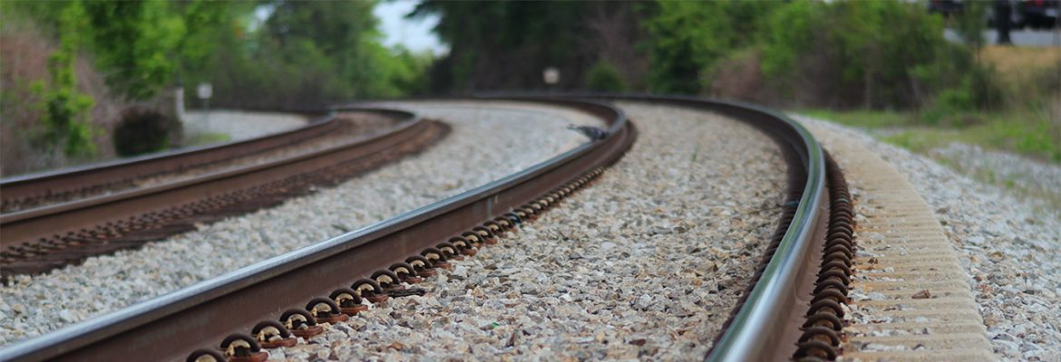
Calculation of Particle Size from Linescan Images of Railroad Ballast
Qing Zhang, 17/03/2022

Slide 2
Indirect measurements
Rubin (2009 paper). Calculate autocorrelation coefficients to calibrate against sieve results. A distribution can be obtained by solving a set of linear equations.
Buscombe (2009 paper). Same idea but use PSD, 2D fourier transform and fractal dimension to replace the autocorrelation coefficients.
Buscombe (2013 paper). Calcualte the Morlet wavelet transform of all or part of the image rows. Each transform is average to obtain an average wavelet PSD of each row. Then results from all rows are averaged as the size distribution.

Slide 3
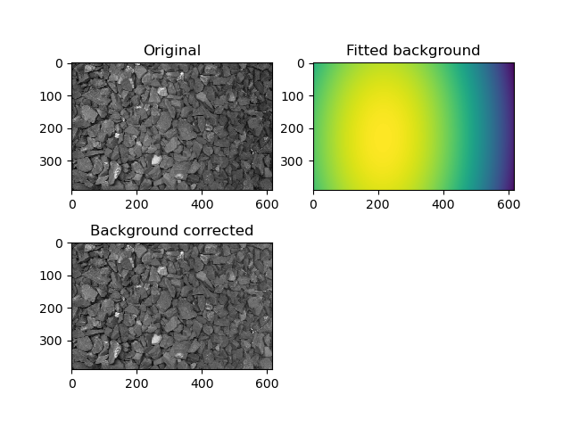
Background Correction
Infra-red background noise
Infra-red illumination pattern
Railway track reflection and shadowing effect
2D surface polynomial fitting

Slide 4
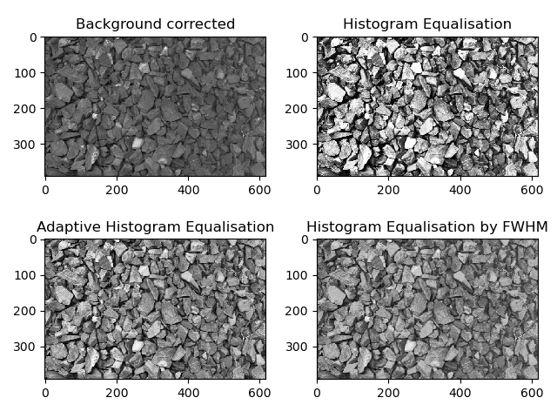
Histogram Equalisation
The aims are:
Improve brightness
Normalise average brightness
Maximize contrast without affecting details

Slide 5
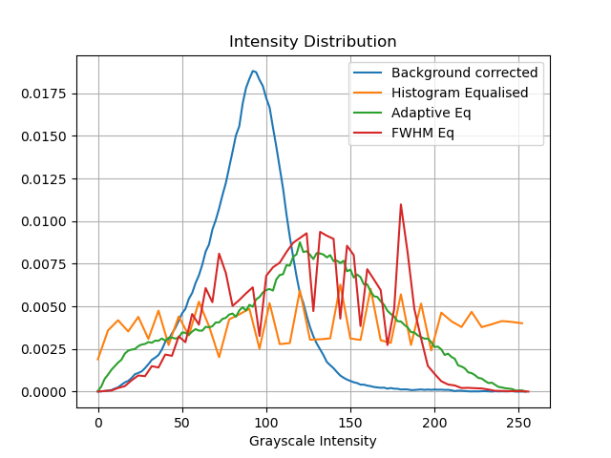
Histogram Equalisation
Adaptive Equalisation from Skimage.Exposure.equalize_adaphist() function seems to provide the best results

Slide 6
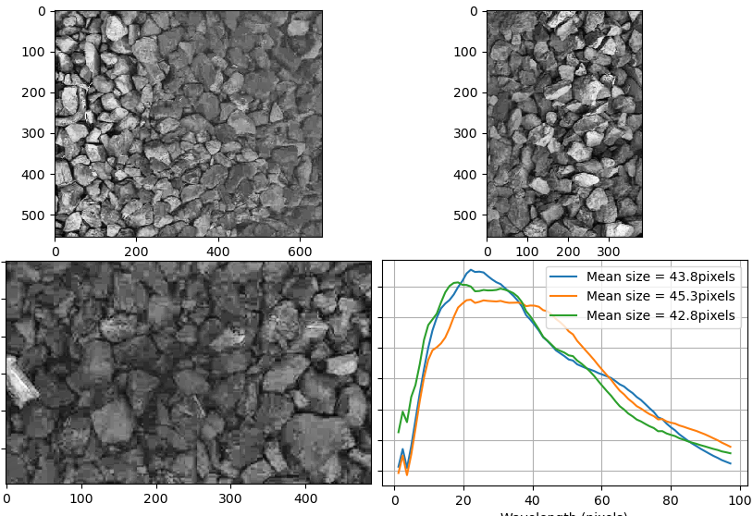
Wavelet Transform Result
Clean ballast with large particles

Slide 7
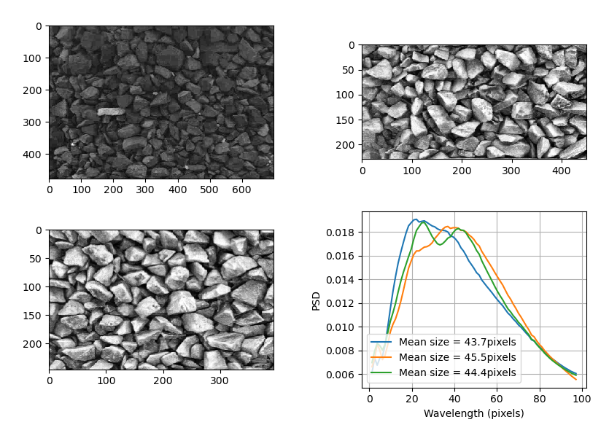
Wavelet Transform Result
Clean Ballast with Medium Particle size

Slide 8
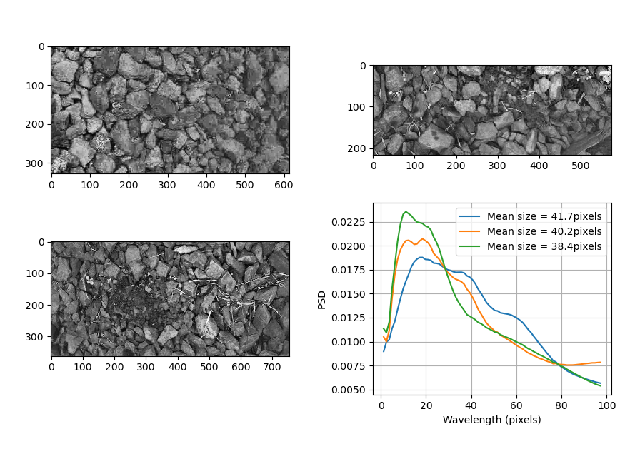
Wavelet Transform Result
Fouled Ballast with Large and Medium Particle Size

Slide 9
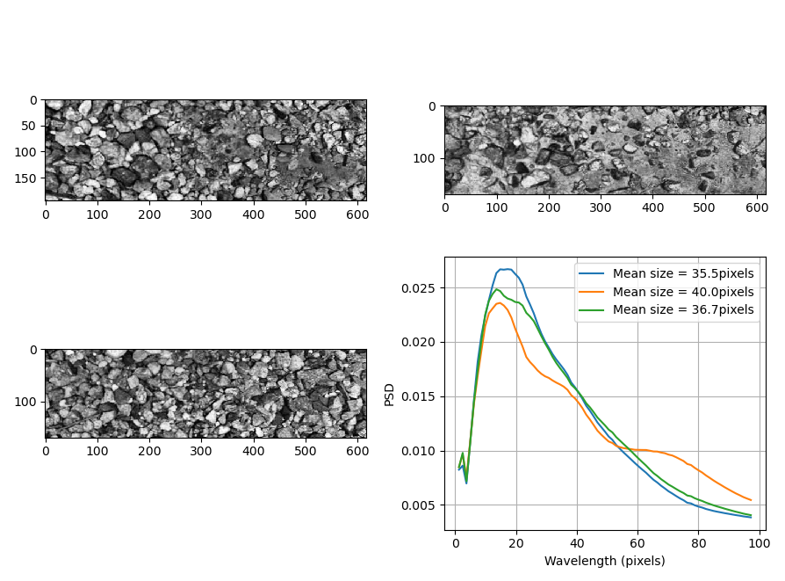
Wavelet Transform Result
Fouled Ballast with small particles

Slide 10
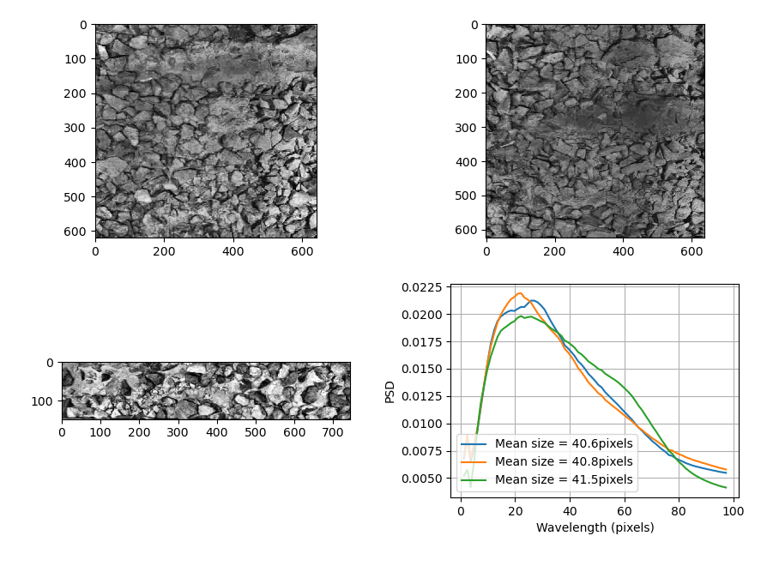
Wavelet Transform Result
Ballast with Muddy spots

Slide 11
Direct Measure
Segmentation using Normalised Cuts. Computation intensity. Lack of adjustments. 2019 paper: Gravel Image Auto-Segmentation Based on an Improved Normalized Cuts Algorithm.
Segmentation using watershed algorithm. 2005 paper, Automated Sizing of Coarse-Grained Sediments: Image-Processing Procedures.
Simple Threshold
Double threshold
Edge Detection/Skeletonise
Bottom-Hat filter/Double threshold
Zetica method using ImageJ presented in a Power Point:
1. Threshold
2. Closing/Dilation to fill up small irregular gaps.
3. Skeletonize.
4. Line Graph for connected pixels and Fractal dimension calculation.

Slide 12
Proposed Method
1. Background correction.
2. Histogram Equalisation.
3. Cartoonize the image by morphological operations.
4. Calculate the foreground markers.
5. Calculate the background markets.
6. Calculate the gradient image.
7. Watershed segmentation.

Slide 13
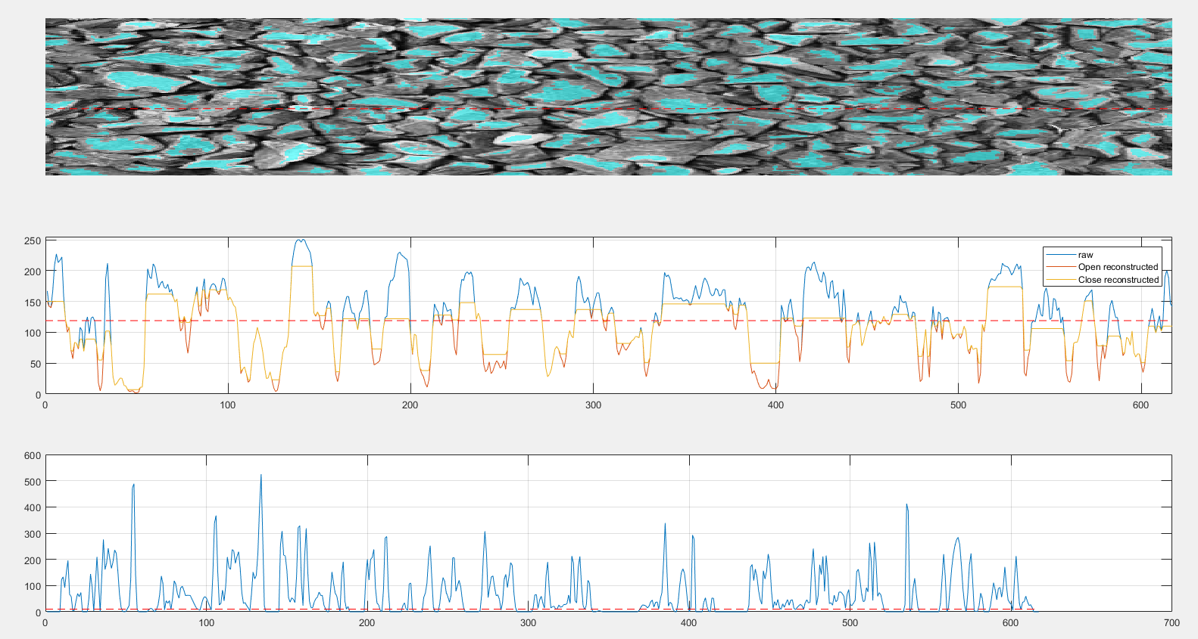
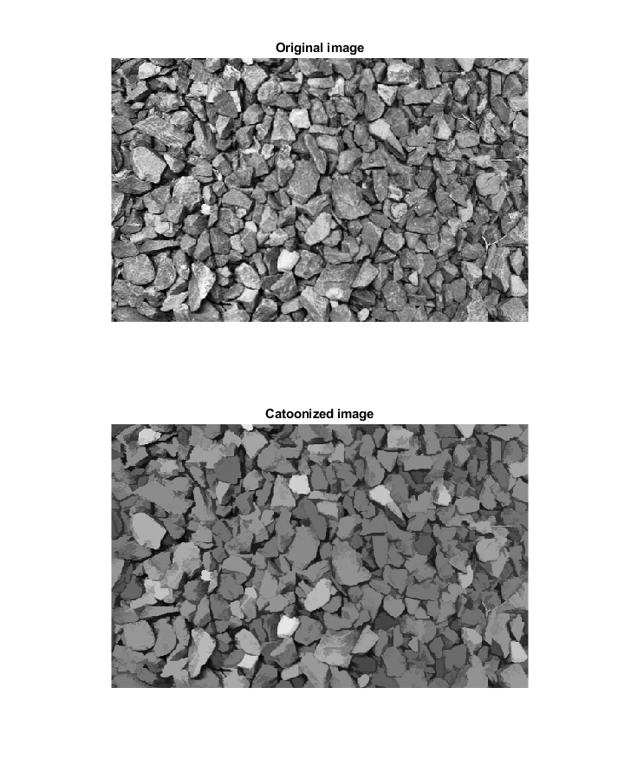
Cartoonize
Objective is to make the particle surface intensity level a plateau.
1. Opening by Reconstruction to saturate the peak.
2. Closing by reconstruction to remove small dips.
3. A simple threshold on the gradient image to label the foreground marker.

Slide 14
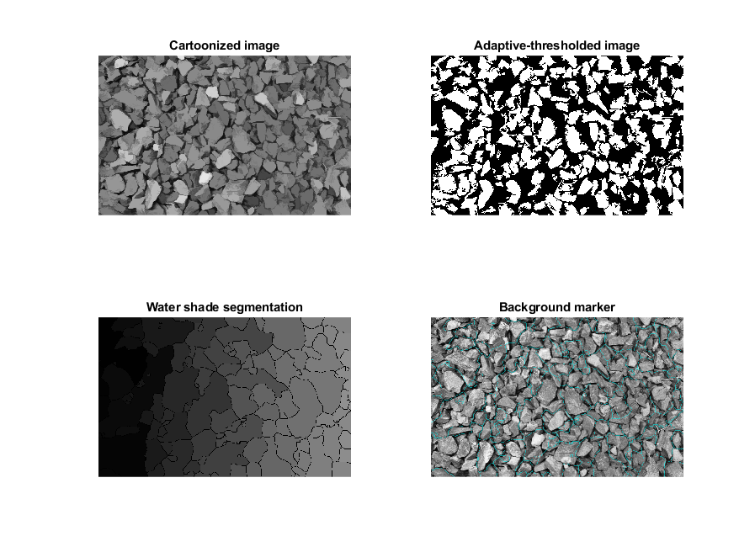
Background Marker
Objective is to label the dark shadow area as the background.
1. Adaptive thresholding to obtain a binary image.
2. Distance transform.
3. Watershed segmentation.
4. Use bounder lines as the background marker.

Slide 15
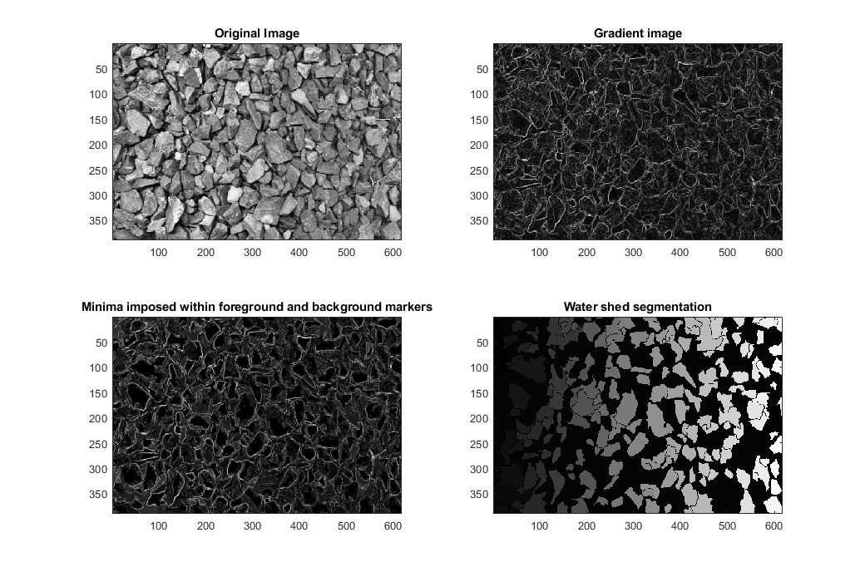
Watershed Segmentation
Objective is to label individual particles using the foreground/background markers.
1. Calculate the gradient image.
2. Keep the minima only within the region of foreground and background markers.
3. Watershed segmentation.

Slide 16
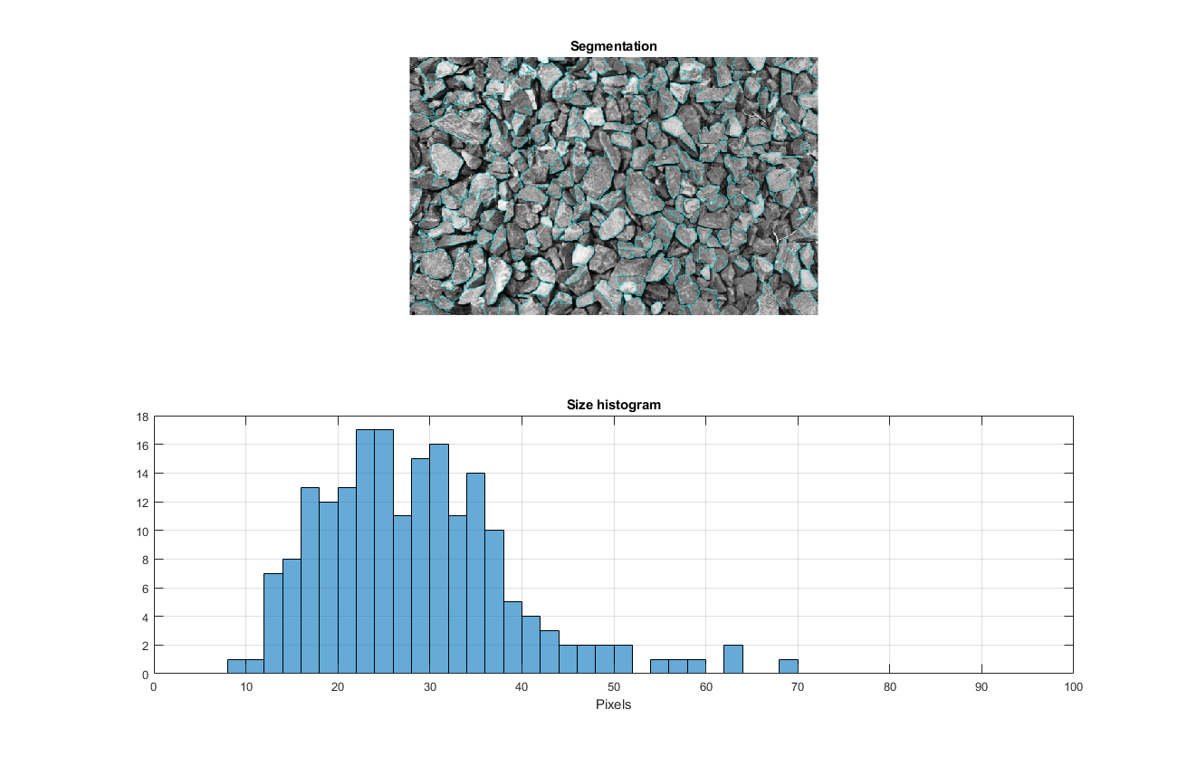
Distribution of sizes
The intermediate size is calculated as the average of long and short axes of each particle.
A size histogram distribution can be obtained for each image.

Slide 17
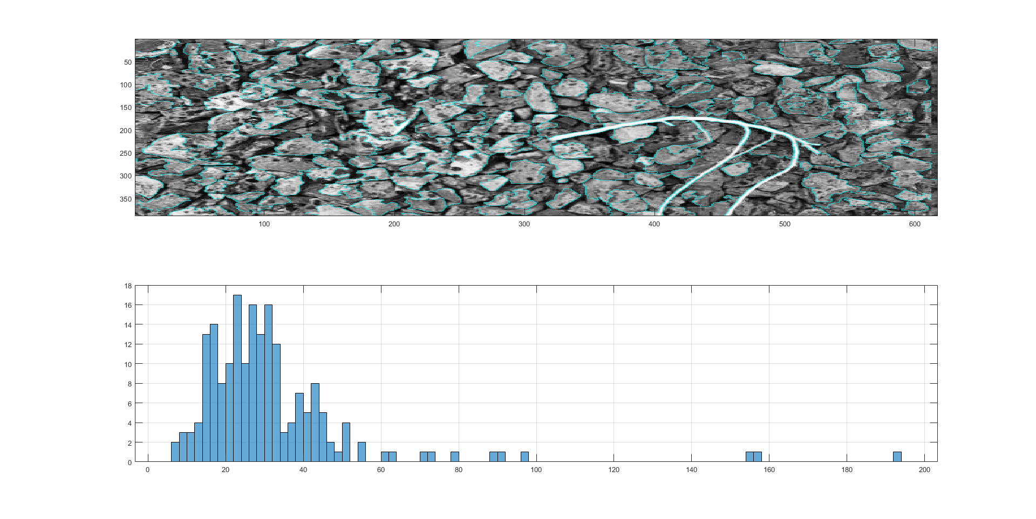
Distribution Example of Large Particles

Slide 18
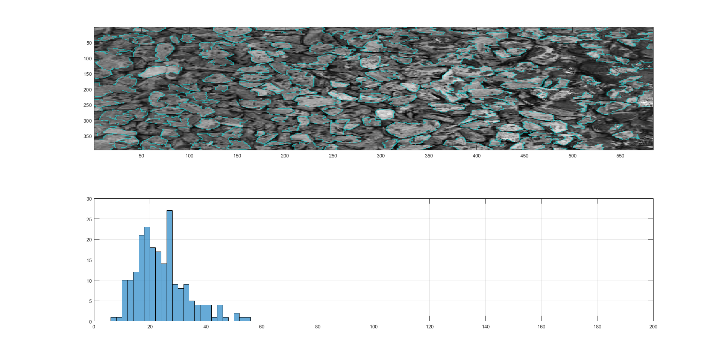
Distribution Example of Smaller Particles

Slide 19
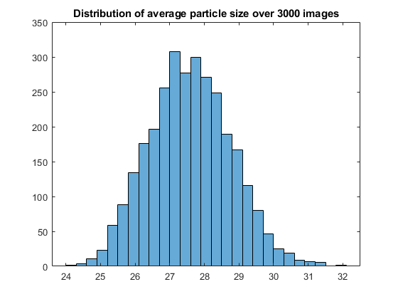
Batch Processing Results
3000 images in total
Relatively clean and uniform distribution of particle sizes.
Average size histogram follows normal distribution.

Slide 20
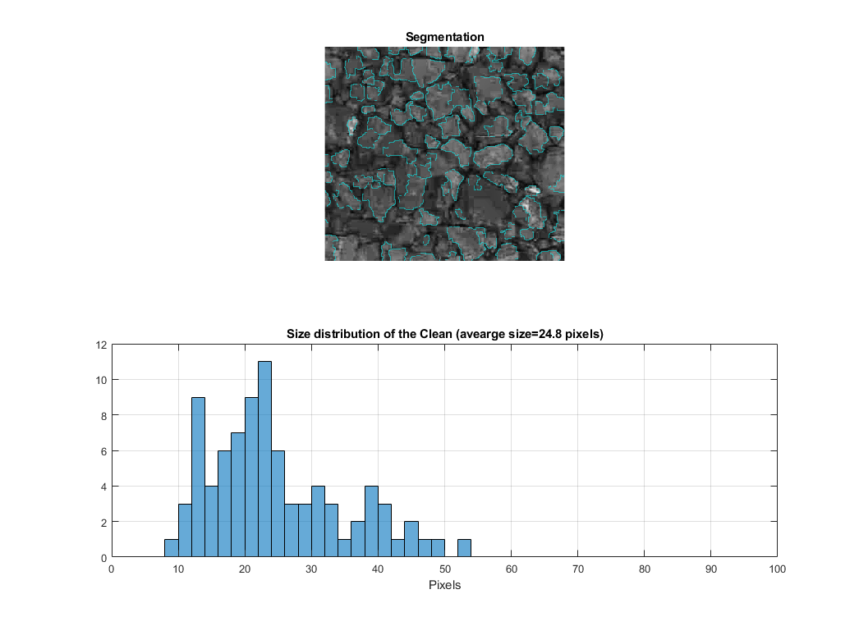
Processing Results
Clean Ballast with Large particles.

Slide 21
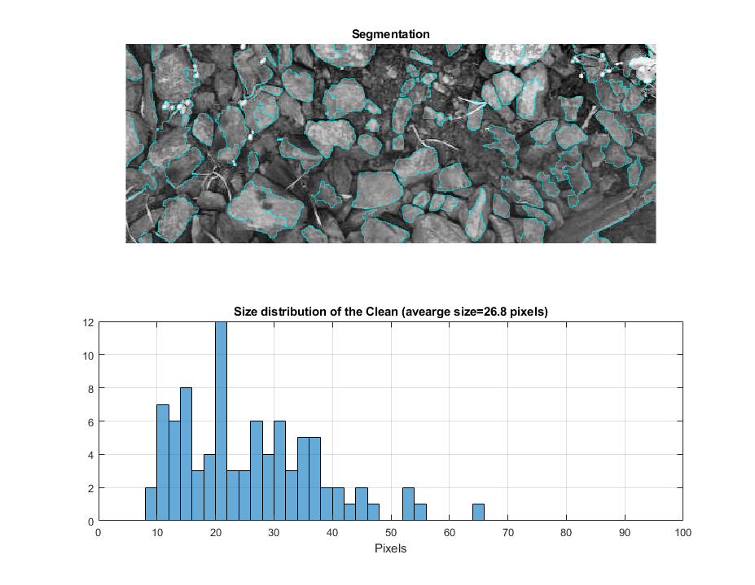
Processing Results
Fouled Ballast

Slide 22
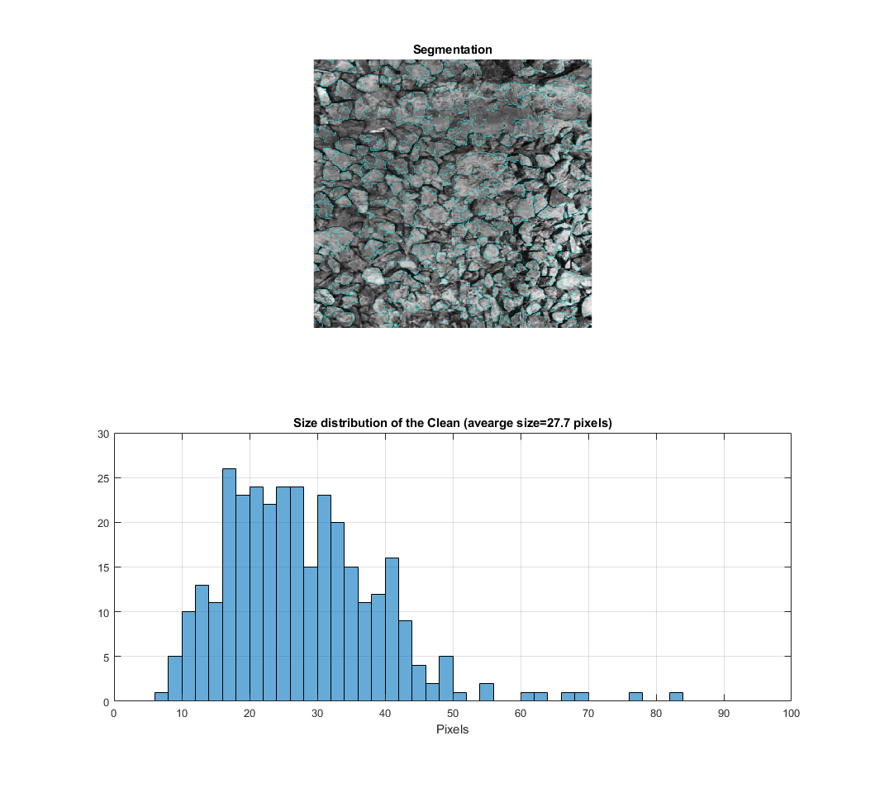
Processing Results
Muddy spots

Slide 23
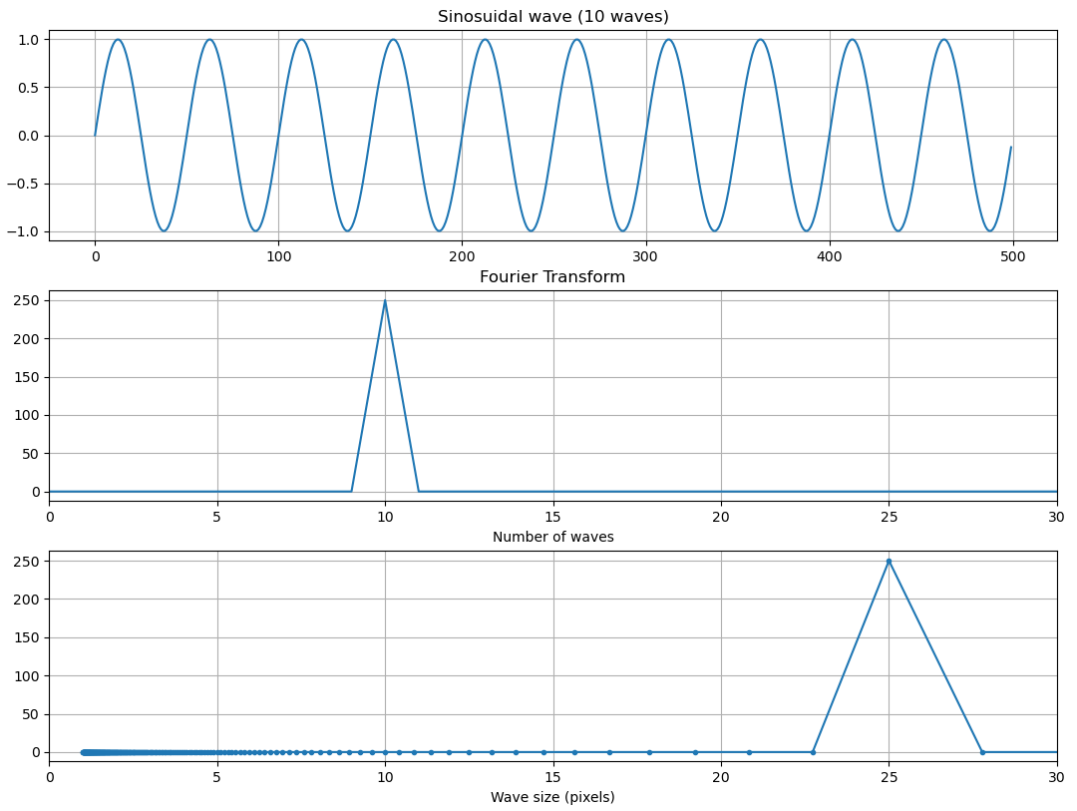
1D-FFT

Slide 24
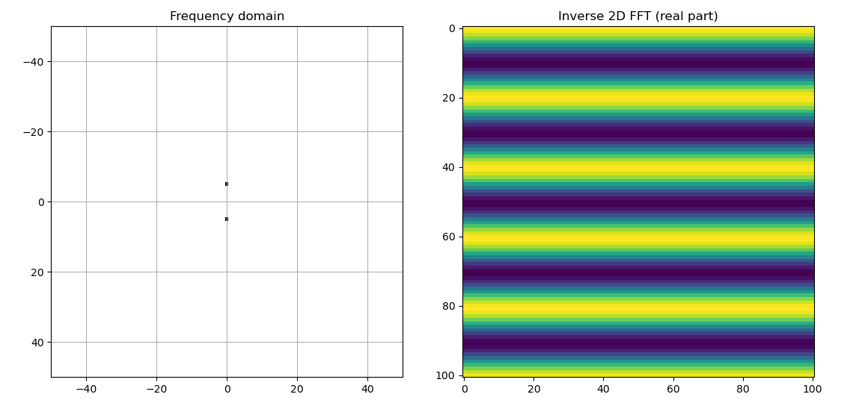
2D-FFT

Slide 25
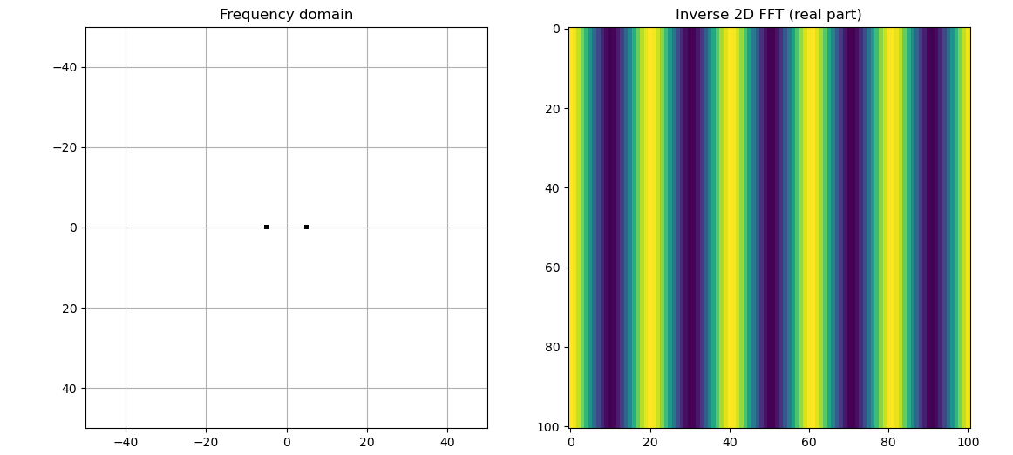
2D-FFT

Slide 26
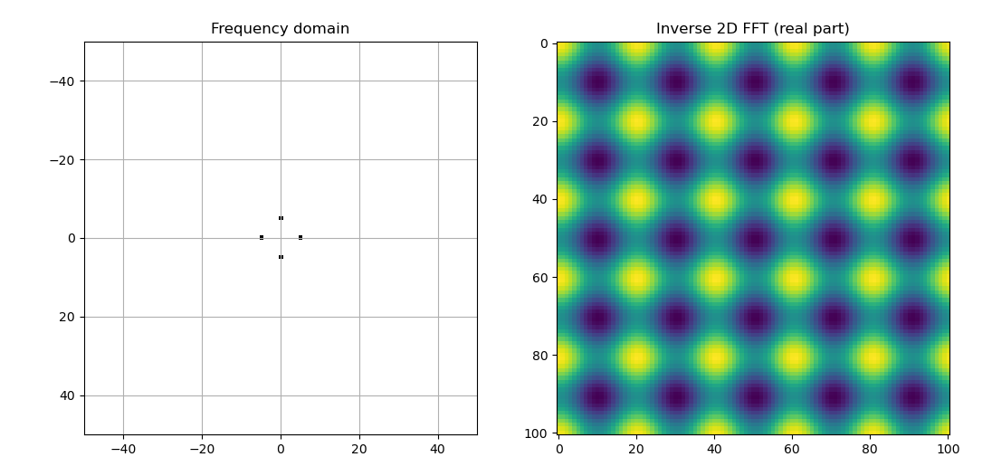
2D-FFT

Slide 27
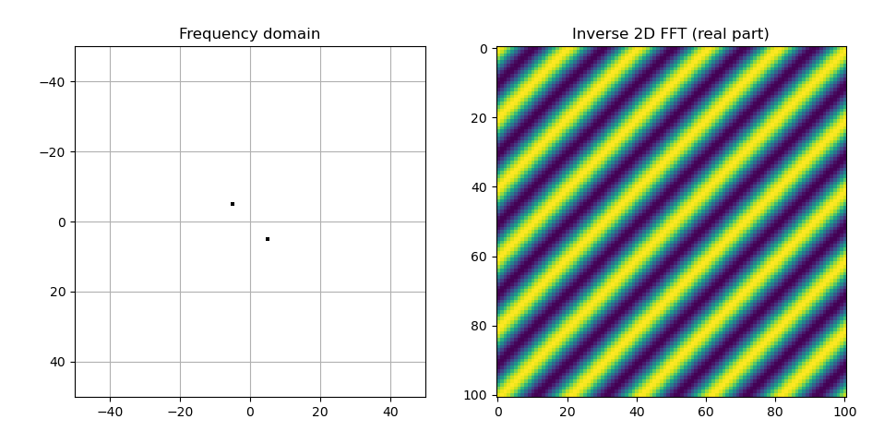
2D-FFT

Slide 28
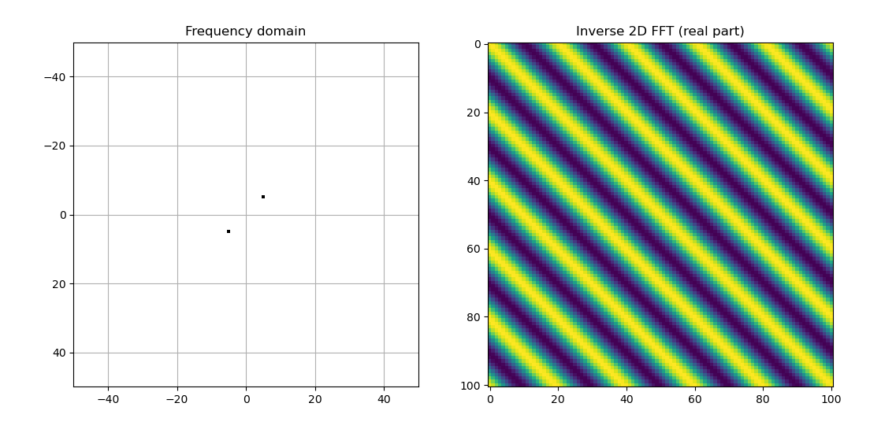
2D-FFT

Slide 29
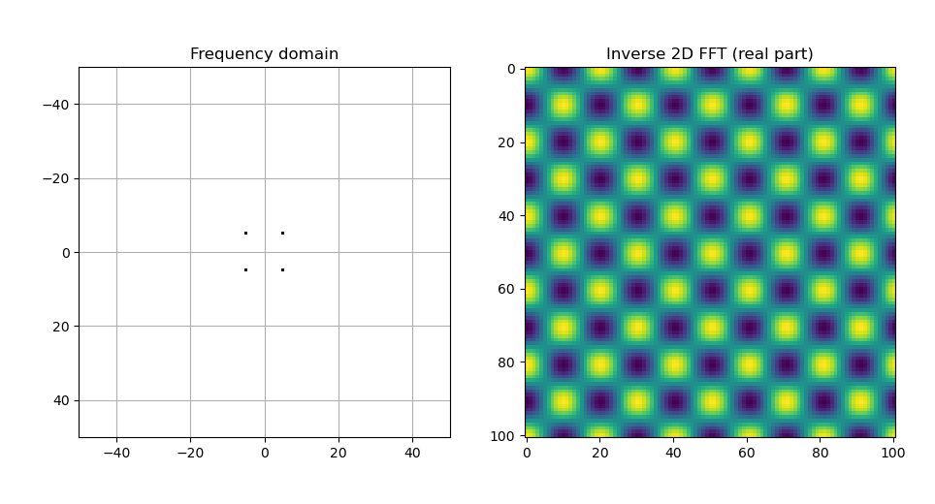
2D-FFT

Slide 30
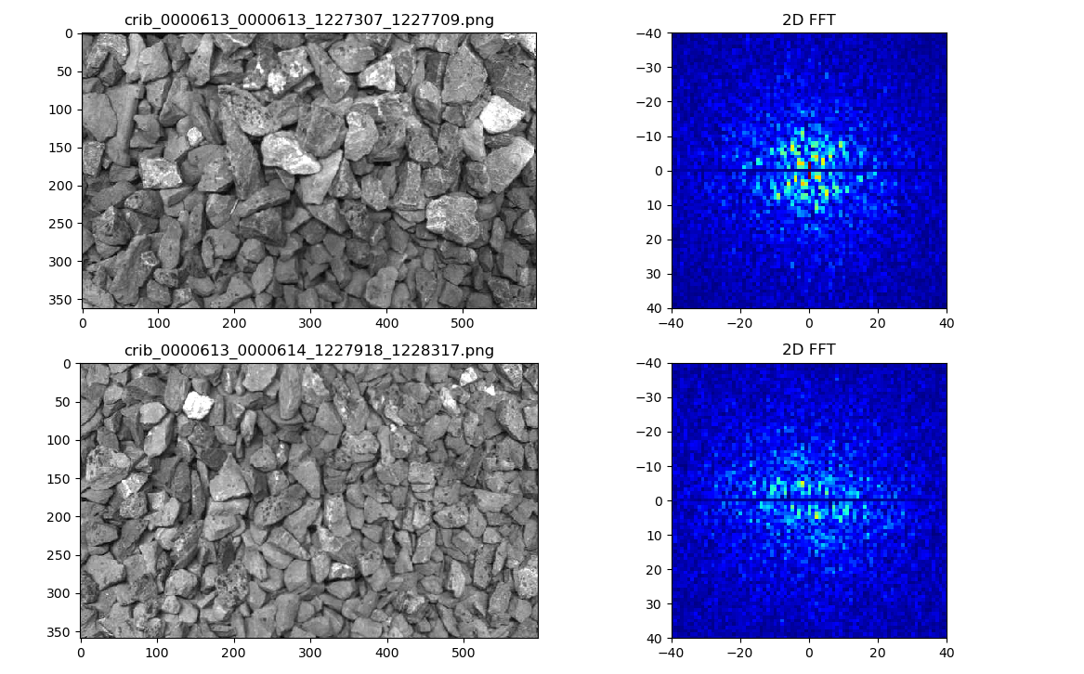
2D-FFT examples (Rio-Tinto)

Slide 31
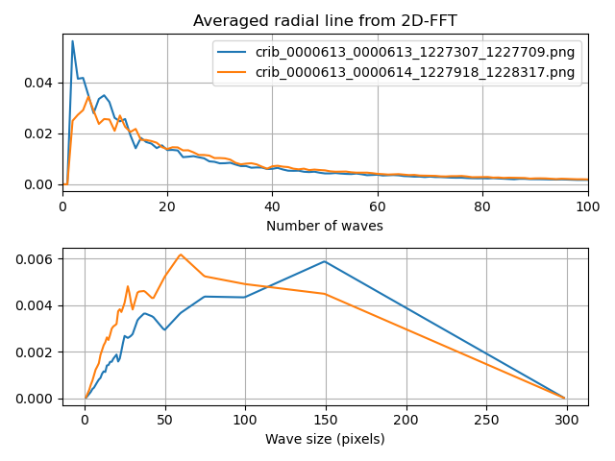
2D-FFT examples (Rio-Tinto)

Slide 32
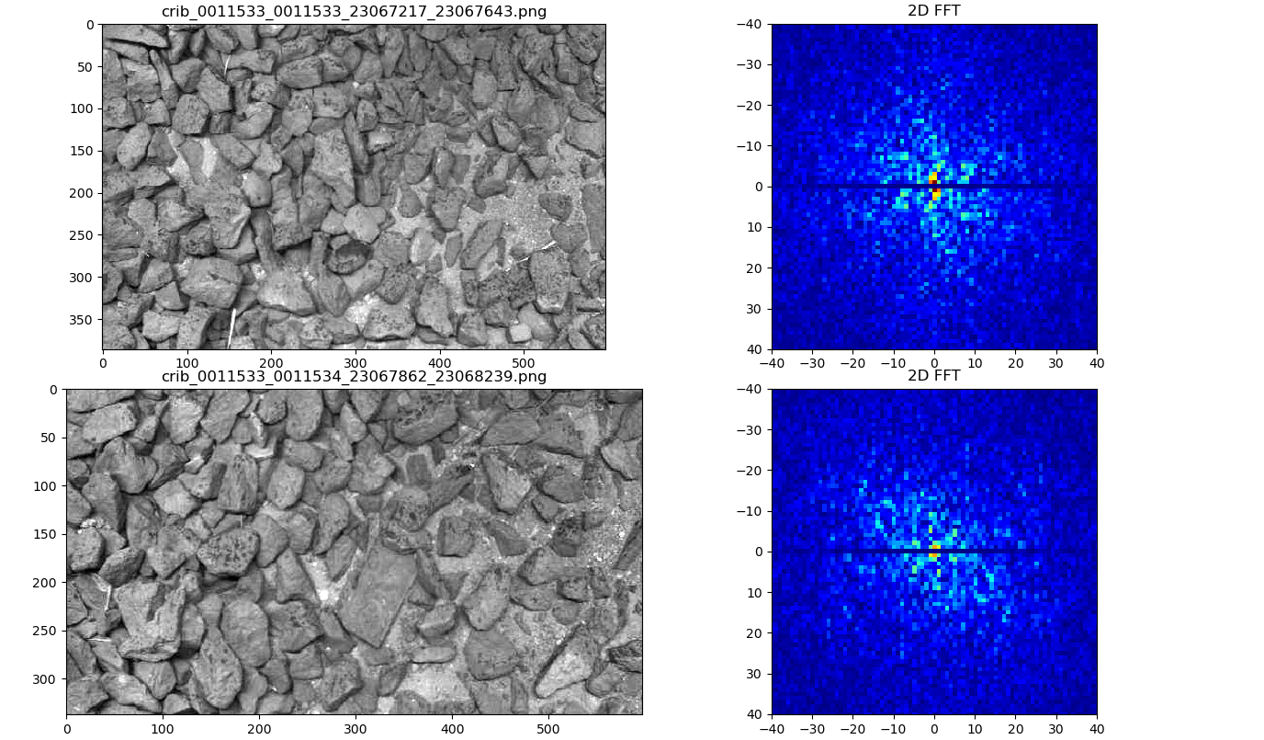
Helping Mud-spot Identification?

Slide 33
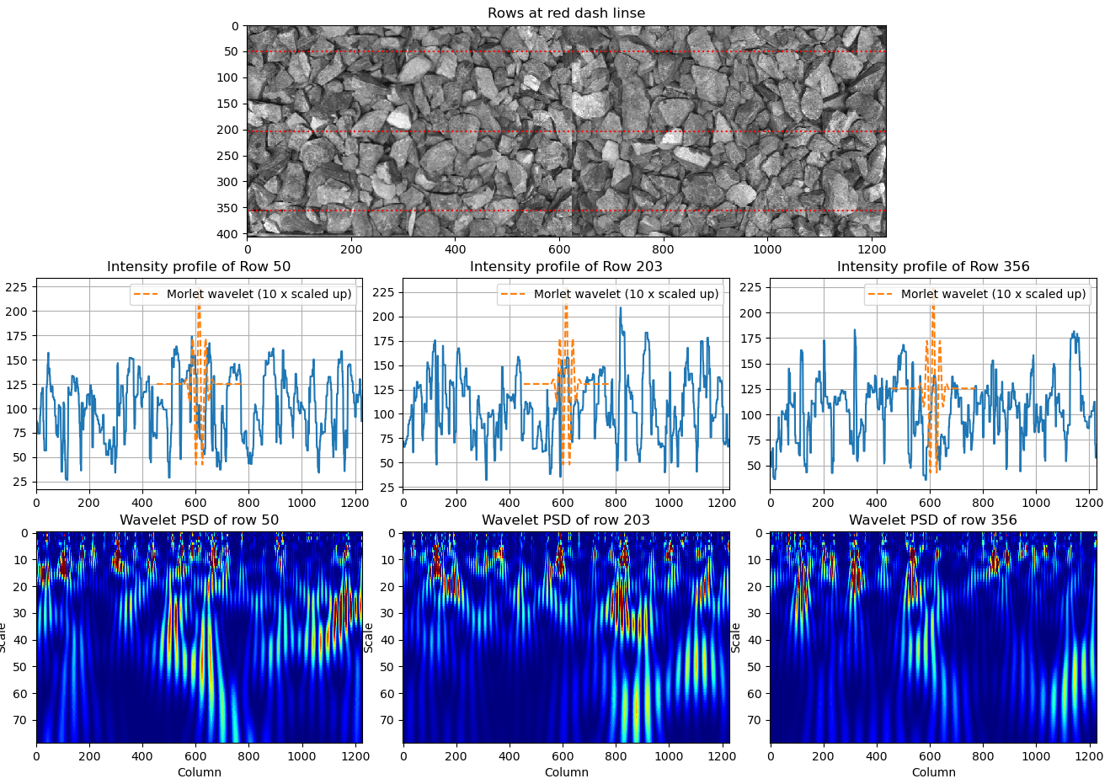
Revisit the Wavelet method
Enjoys a better resolution (the wavelet can be scaled to any resolution).
Family of wavelet to choose from.
PSD needs to be normalised by the wavelength^2

Slide 34
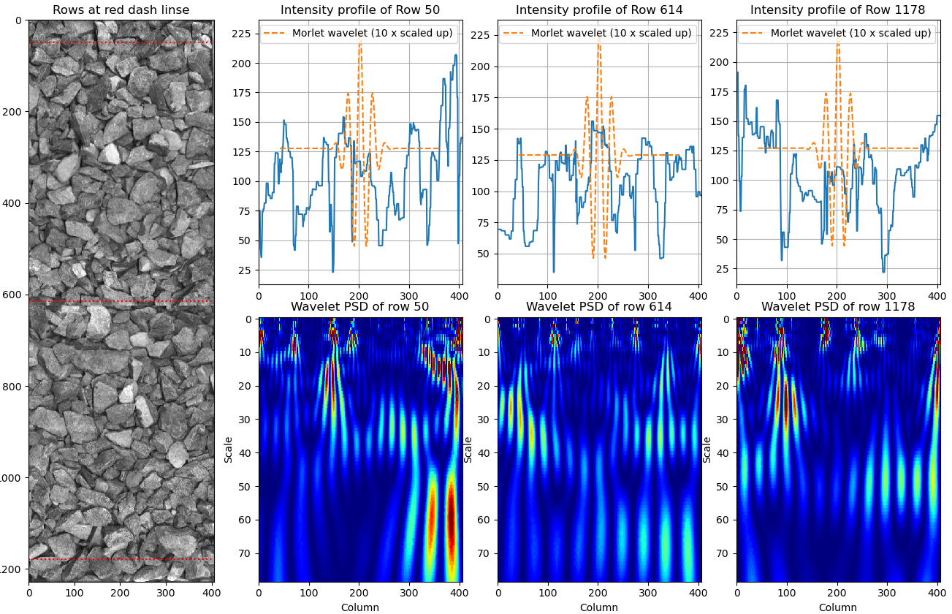
Wavelet Method
Data length affects the stability of the transform
Rows are favoured over columns

Slide 35
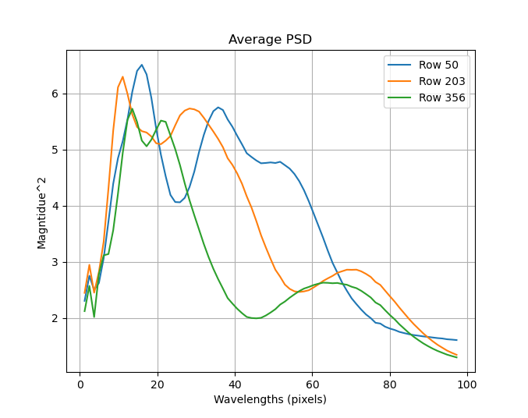
Wavelet Method
Averaging

Slide 36
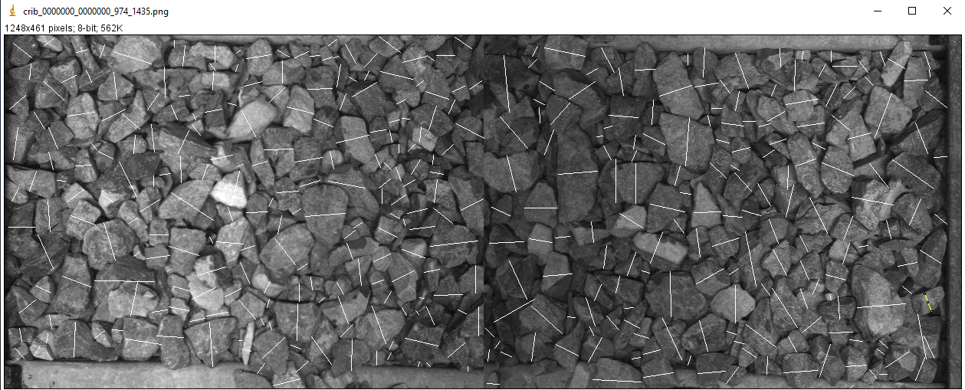
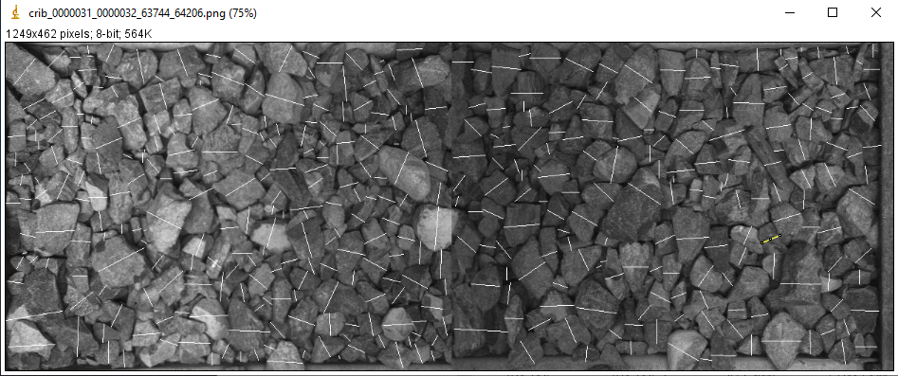
Manually Derived Particle Sizes
For each particle, first work out the longest axis.
Second, draw a line perpendicular to the longest axis
The secondary axis is the most relevant to sieve analysis (fall through by the short axis).

Slide 37
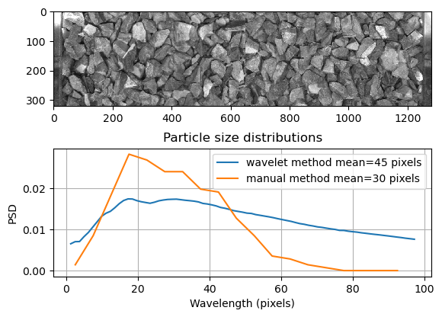
Wavelet Results
Large particle sizes

Slide 38
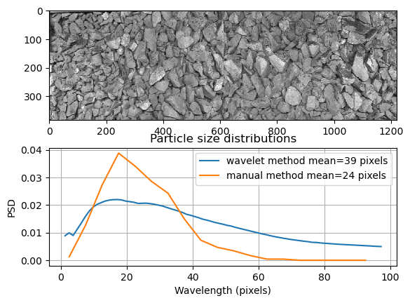
Wavelet Results
Large and small particle sizes

Slide 39
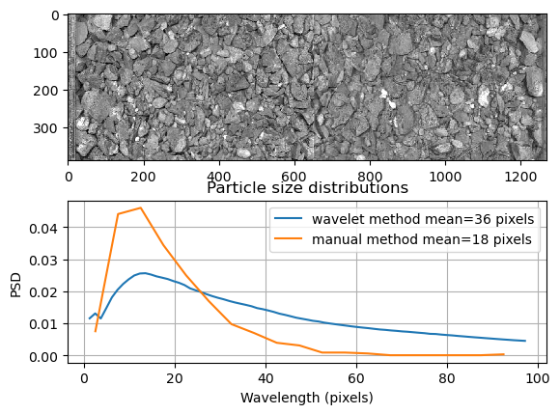
Wavelet Results
Fine particles

Slide 40
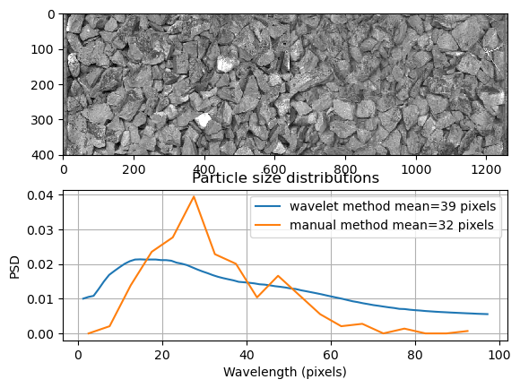
Wavelet Results
Large particle sizes but underestimated by the wavelet method, possibly down to oil contamination (high frequency components).

Slide 41
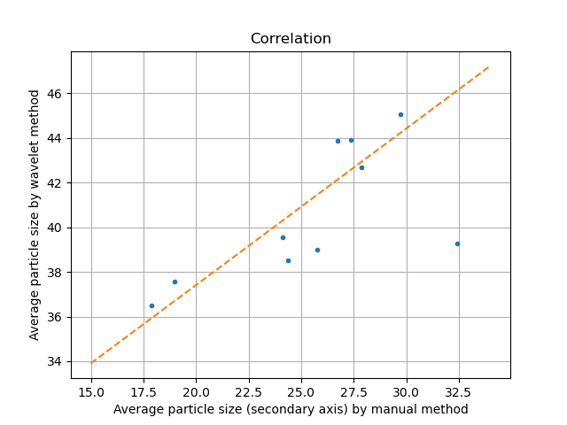
Wavelet Results
Without the single outlier, a good correlation is achieved.

Slide 42
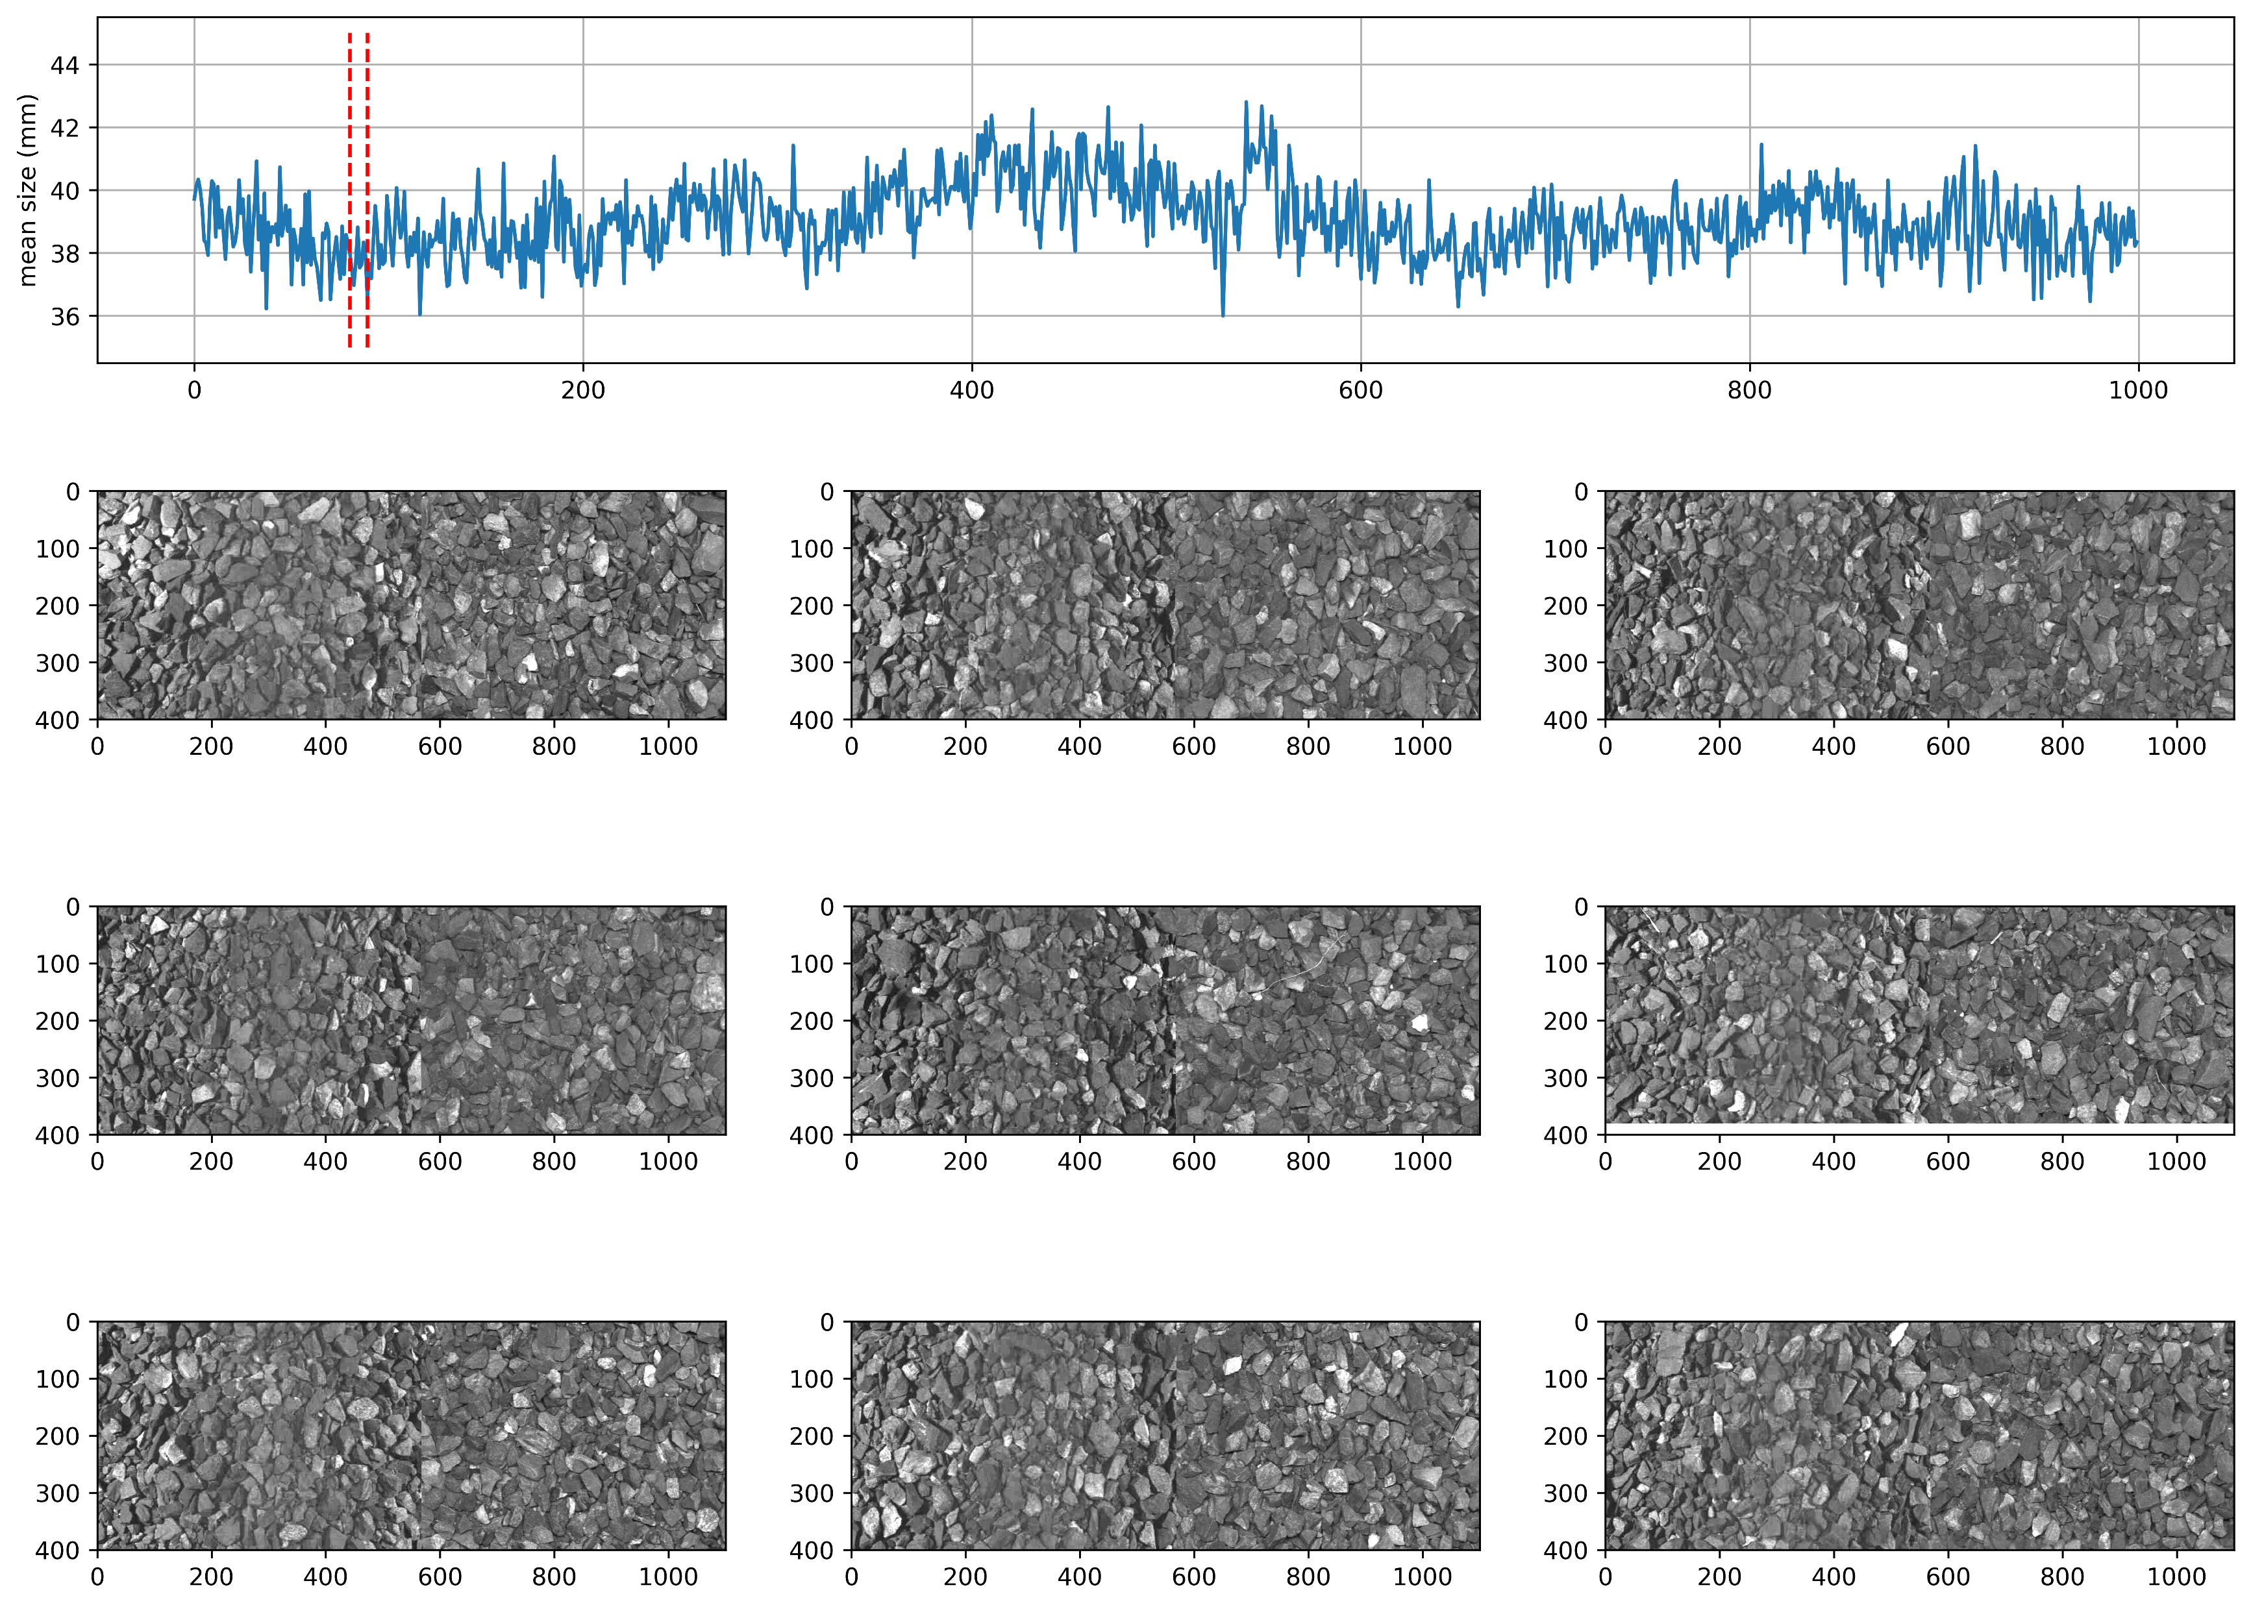
Run 354 from ARC on a standard 1435 Gauge
1000 valid images processed.
A section from image number 80-89 are showing as examples of small particles

Slide 43
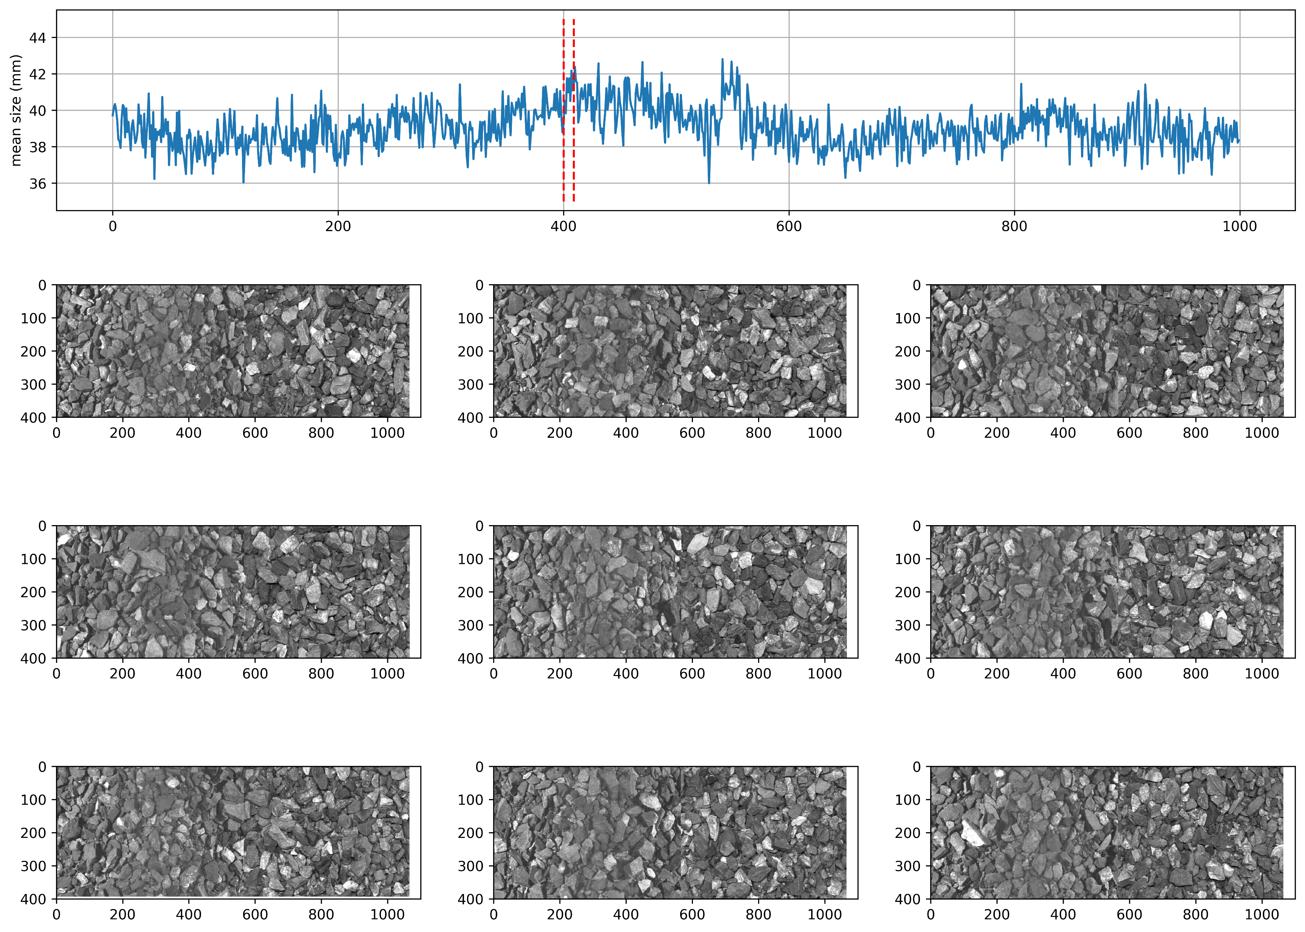
Run 354 from ARC on a standard 1435 Gauge
A section from image number 400-409 are showing as examples of large particles

Slide 44
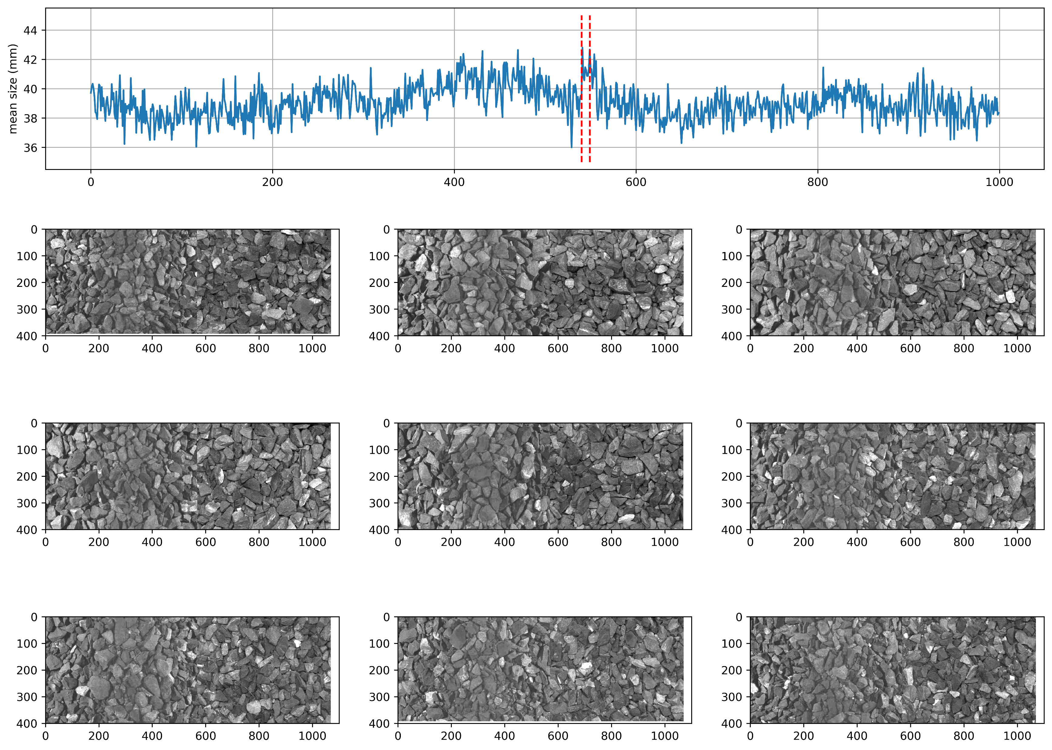
Run 354 from ARC on a standard 1435 Gauge
A section from image number 540-549 are showing as examples of large particles

Slide 45
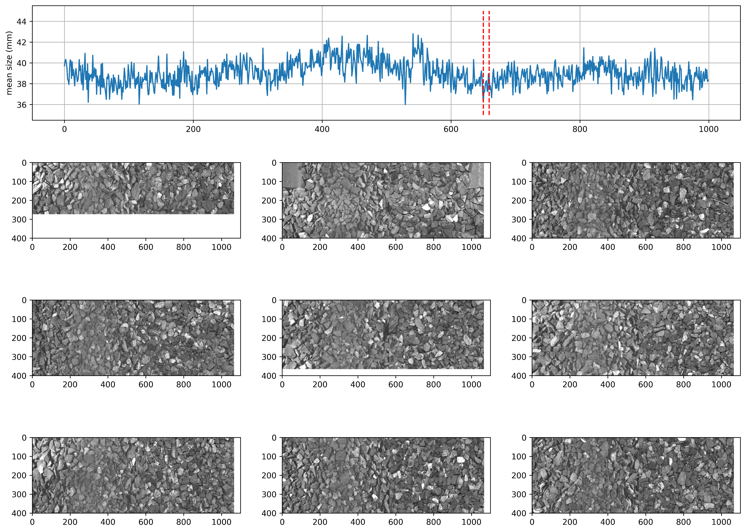
Run 354 from ARC on a standard 1435 Gauge
A section from image number 650-659 are showing as examples of small particles

Slide 46
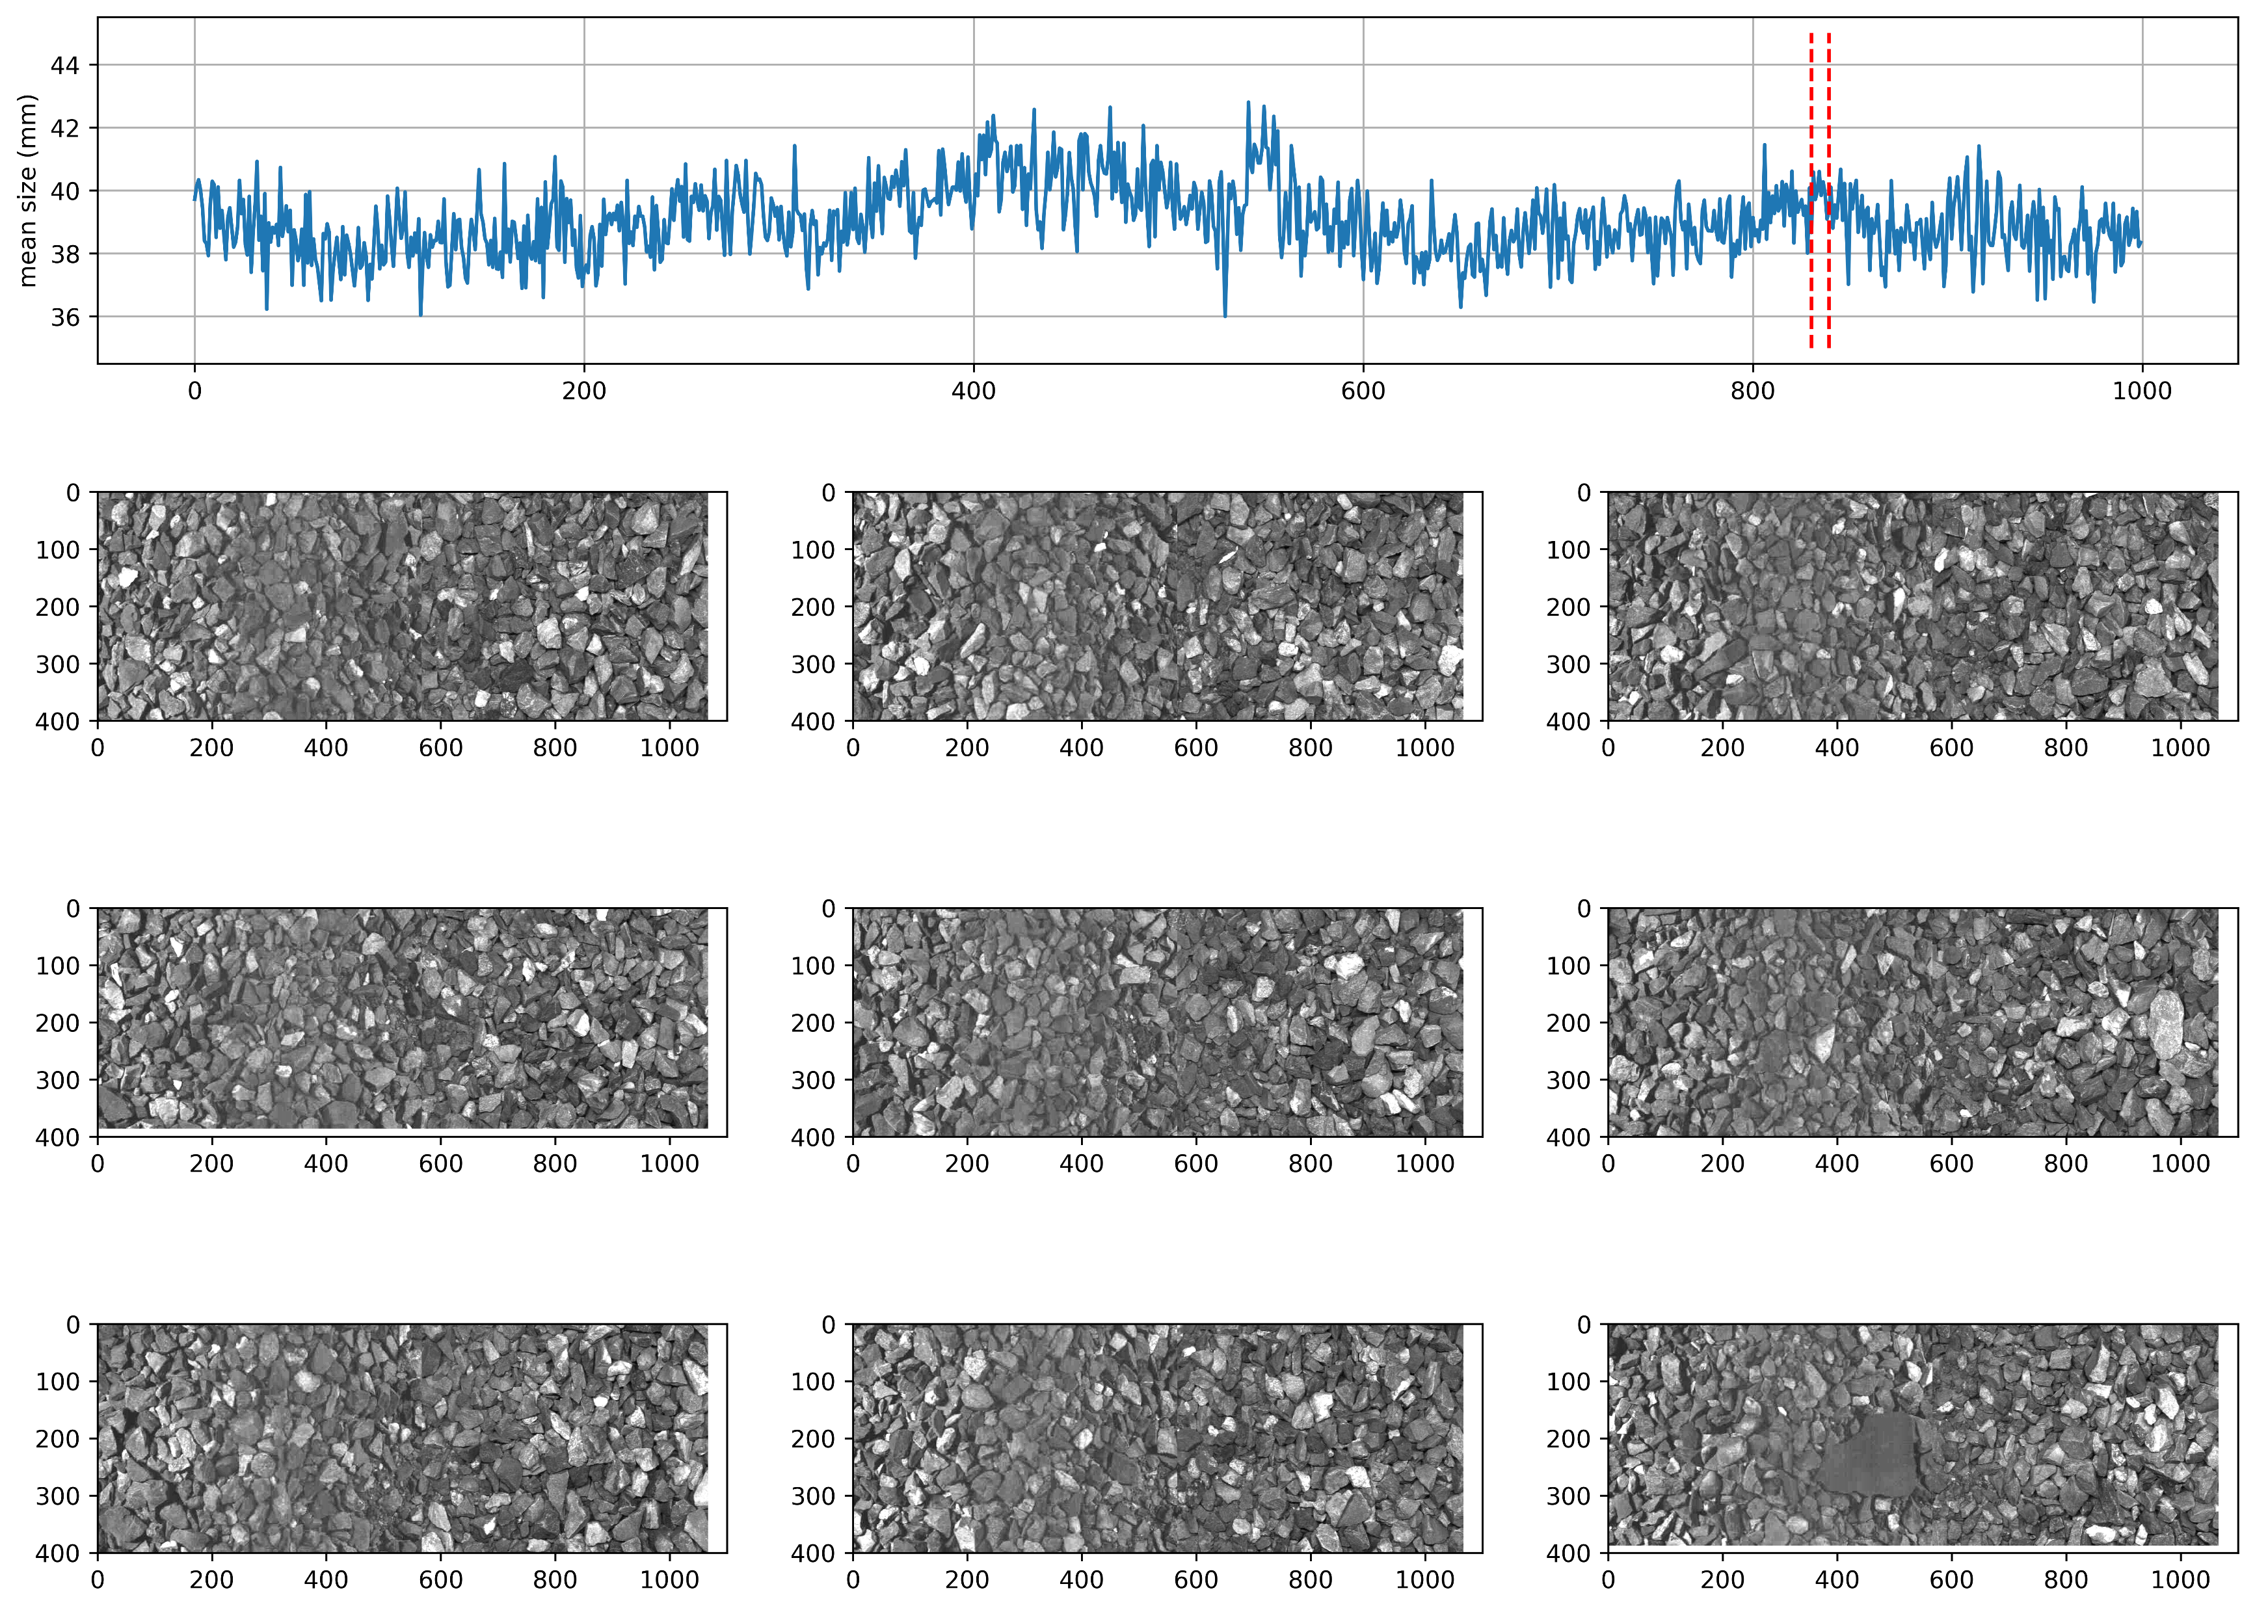
Run 354 from ARC on a standard 1435 Gauge
A section from image number 830-839 are showing as examples of medium particles

Slide 47
Questions?

